Slide 1

Client-side Scripting

Slide 2
Client-side Scripting
Run JavaScript on the client (web browser) when client-based events occur, such as when a form loads, after form submission, or when a field changes value.
Capabilities:
Disable list editing for the table.
Create appropriate business rules or access controls for list editing.
Create data policies.
Create a separate onCellEdit client script.

Slide 3
Client Scripts
Configure forms, form fields, and field values while the user is using the form
Capabilities:
make fields hidden or visible
make fields read only or writable
make fields optional or mandatory based on the user's role
set the value in one field based on the value in other fields
modify the options in a choice list based on a user's role
display messages based on a value in a field

Slide 4
UI Script
Provide a way to package client-side JavaScript into a reusable form, similar to how script includes store server-side JavaScript.
Administrators can create UI scripts and run them from client scripts and other client-side script objects and from HTML code.
To create UI scripts, navigate to System UI > UI Scripts and create or edit a record

Slide 5
Catalog Client Scripts
Catalog client-side scripts can add dynamic effects and validation to forms. Scripts can apply to service catalog items or variable sets, allowing administrators to use the same functionality that is available on other forms.
Capabilities:
Get or set variable values.
Hide or display variables.
Make variables mandatory or not.
Validate form submission.
Add something to the cart.
Order something immediately.

Slide 6

Catalog Client Scripts
Example
Notes:
Example: Restrict the number of characters a user can type in a variable
This is an example of a script that runs when the variable is displayed, rather than when the item is ordered.
6

Slide 7
AJAX
Client scripting for mobile is identical to scripting for the web, with some exceptions. All new scripts must conform to certain guidelines.
The following items are affected on the mobile platform:
Client scripts
UI policies
Navigator modules
UI actions
Notes:
If you have some experience in web app development, you may be familiar with AJAX which stands for Asynchronous JavaScript And XML.
AJAX enables web applications to send and retrieve information to and from a server in the background, without impacting the user experience with the displayed web page.
7

Slide 8
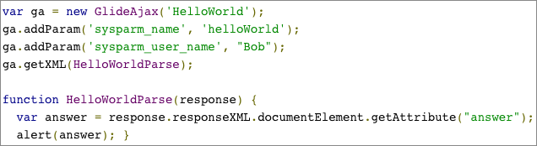
GlideAjax
Allows the execution of server-side code from the client
Example:
Notes:
GlideAjax calls pass parameters to the script includes, and, using naming conventions, allows the use of these parameters.
8

Slide 9
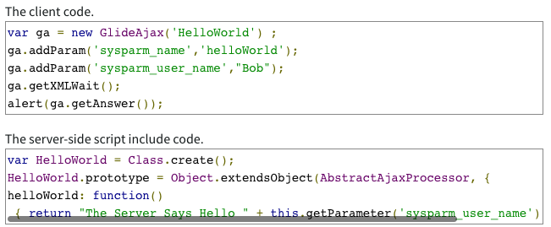
GlideAjax
Example of asynchronous GlideAjax script
Notes:
Shown in the current slide is an example of an asynchronous GlideAjax script that displays a message from the server as an alert dialog in the browser.
As you can see, there are two parts to the asynchronous GlideAjax script: client-side and server-side code.
9

Slide 10
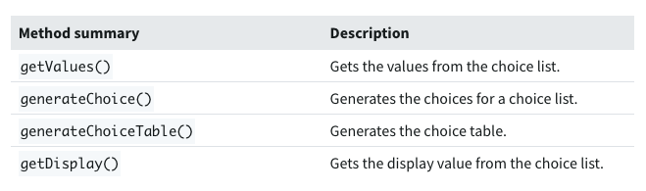
AJAXClientHelper
Provides helper functions for AJAX clients to retrieve displayed values from a choice list
Notes:
Use this script include wherever your need to generate choice lists or retrieve a value from an Ajax client.
10

